Slide 1
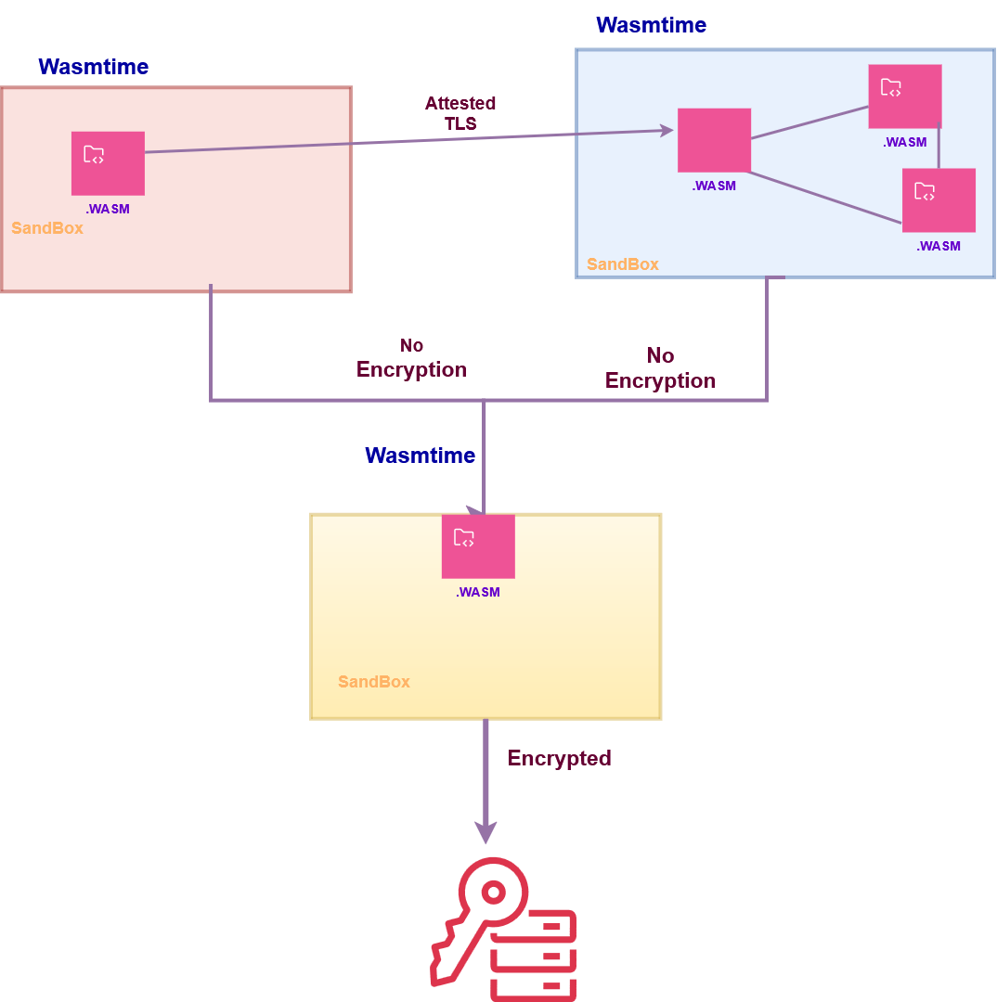
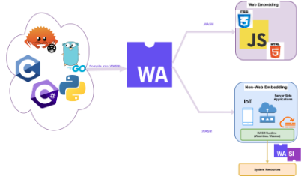
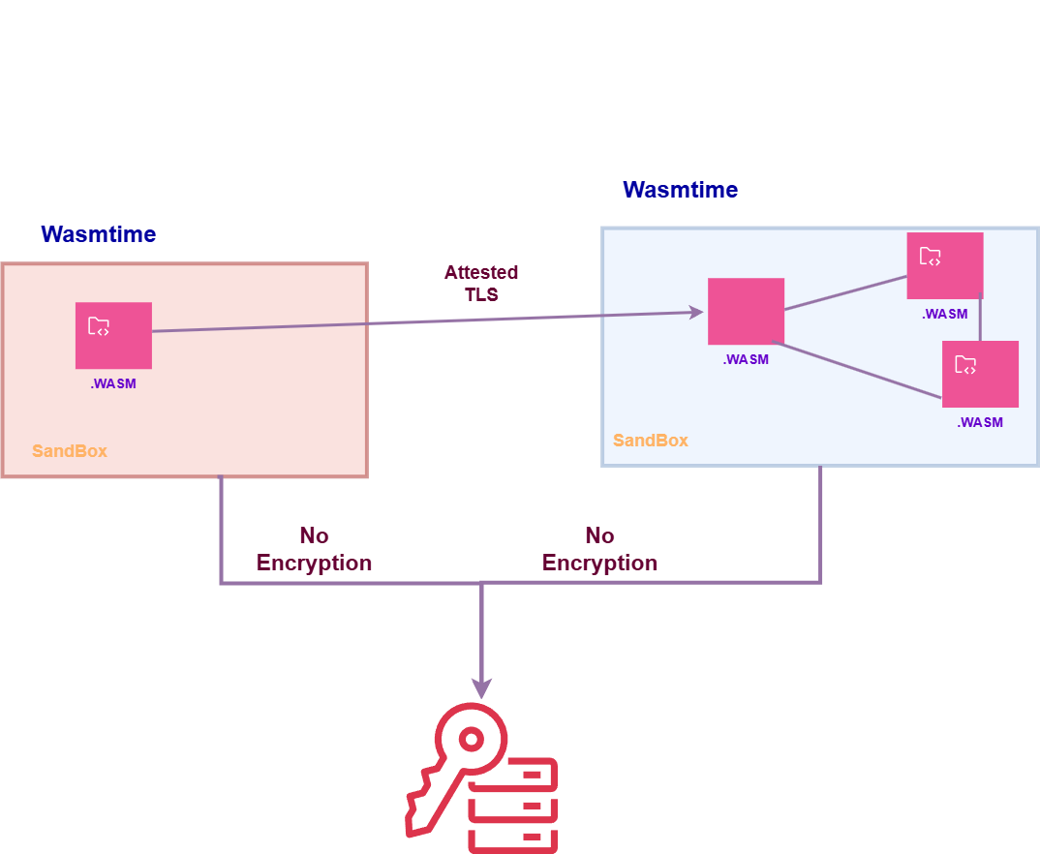
Secure Systems Group, Aalto University
ELASTIC Project
Flexible access control for WebAssembly-based serverless computing
Shahd Omer, Lachlan J. Gunn
What is WebAssembly (Wasm)?
Wasm is a hardware-independent instruction set, used to compile cross-platform applications from languages like Rust, Go and C/C++.
WebAssembly System Interface (WASI)
Interfaces allowing Wasm code to access outside functionality (e.g. filesystem, network).
Security: WASI interfaces often describe access control in terms of capabilities, i.e. handles allowing an application to access something
Examples:
Directory handle
Network capability handle
Possible capabilities are determined by what the runtime implements : e.g. limitation to a directory.
How it works
Wasm can be run either embedded inside the browser, or in a standalone or cloud-based runtime.
Communication with the underlying system is handled by the runtime which controls all access to resources.
Flexible access control
New approach: custom capabilities defined with Wasm components (“shims”).
Examples:
Component can only write valid PDFs
Output to stdout has prefix added
Challenges
Which components need which shims?
Confused deputy attacks
Widely differing runtime environments (browser, cloud, local apps)
Funded by the European Union. Views and opinions expressed are however those of the author(s) only and do not necessarily reflect those of the European Union or SNS-JU. Neither the European Union nor the granting authority can be held responsible for them.

